Slide 1
CUSTOMER BEHAVIOUR AND CHURN ANALYSIS
Data Analysis Internship – Week Assignment
Semu Msongole
Data Analyst Intern

Slide 2
Objectives of the Analysis
Objectives
Understand the composition of the customer base
Identify customer segments with high churn
Assess the relationship between contract type and retention
Examine the relationship between tenure and loyalty
Analyze service and payment-method patterns
Provide actionable recommendations to management

Slide 3
Dataset Overview
Dataset: Telco Customer Churn Dataset
Unit of Analysis: One row represents one customer
Key Analytical Fields;
Customer Demographics
Tenure
Contract Type
Churn Status
Internet Service
To name a few

Slide 4
Executive Summary
KPI | Result
Total Customers | 7,043
Churned Customers | 1,869
Overall Churn Rate | 26.54%
Retained Customers | 5,174
Retention Rate | 73.46%
Average Tenure | 32.37 months
Average Monthly Charge | 64.76

Slide 5
Customer Base
73.46%
Retained
26.56%
Churn

Slide 6
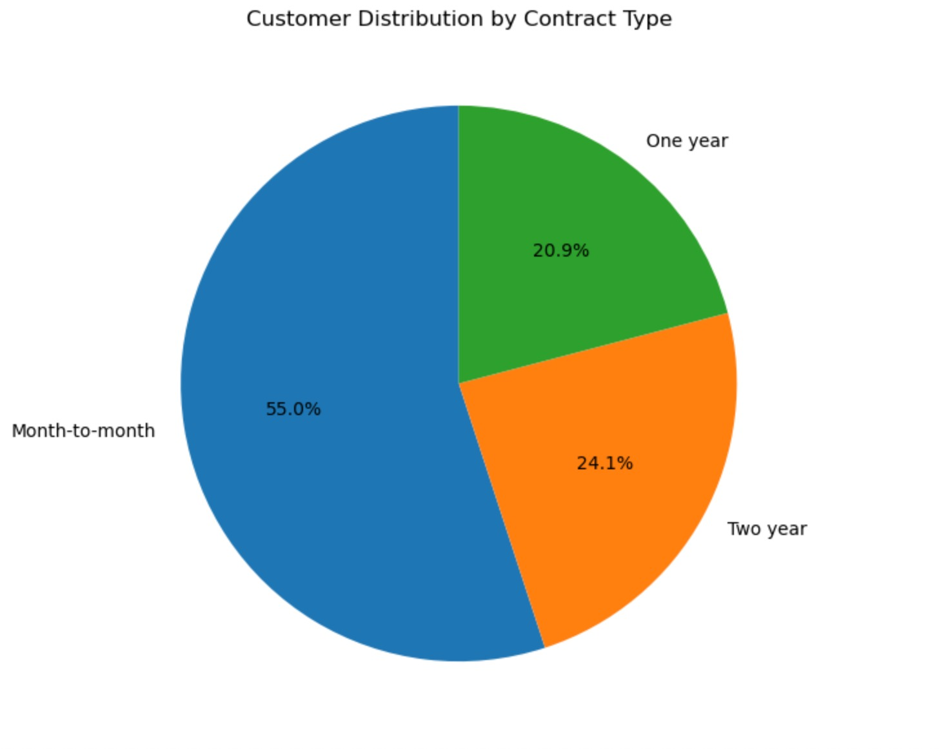
Customer Distribution By Contract Type

Slide 7
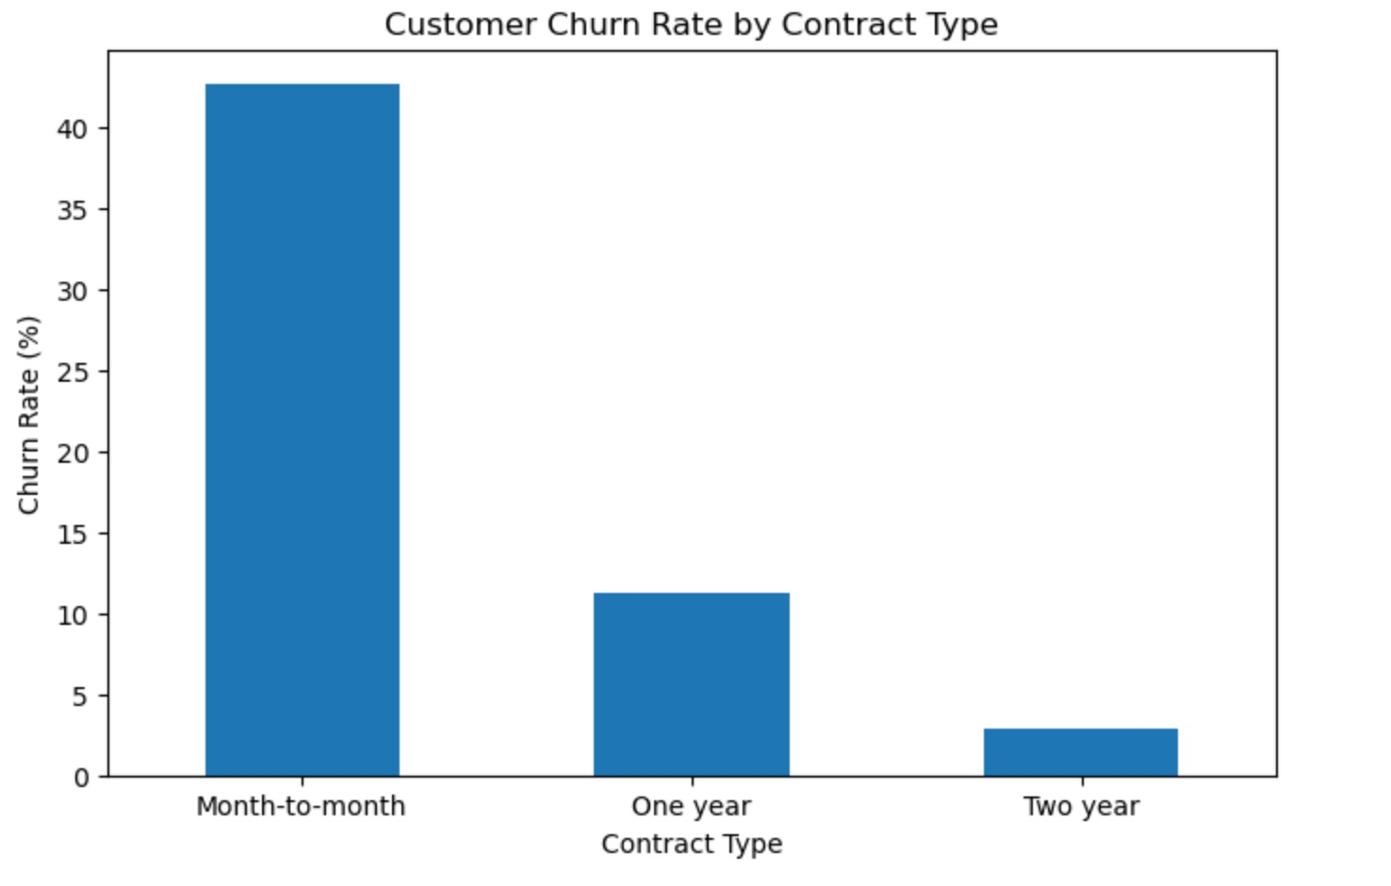
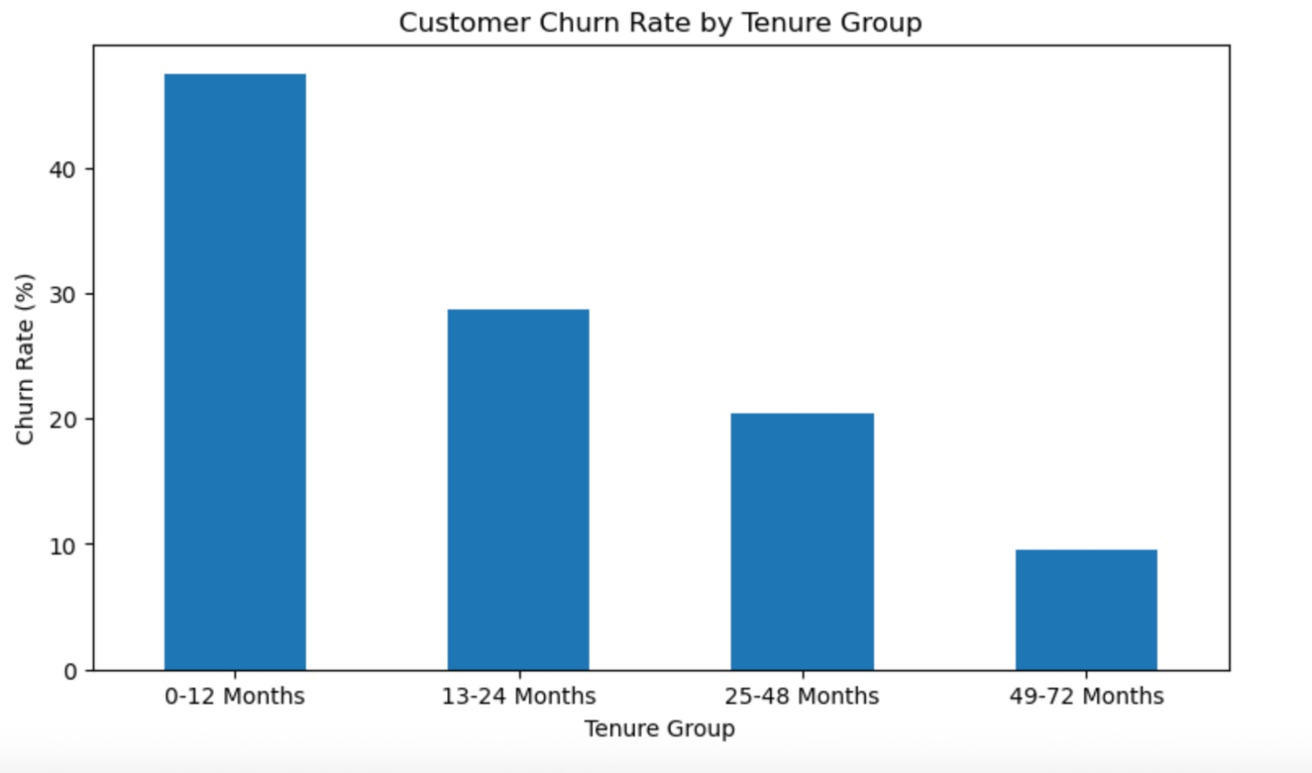
Where is Churn Highest?

Slide 8
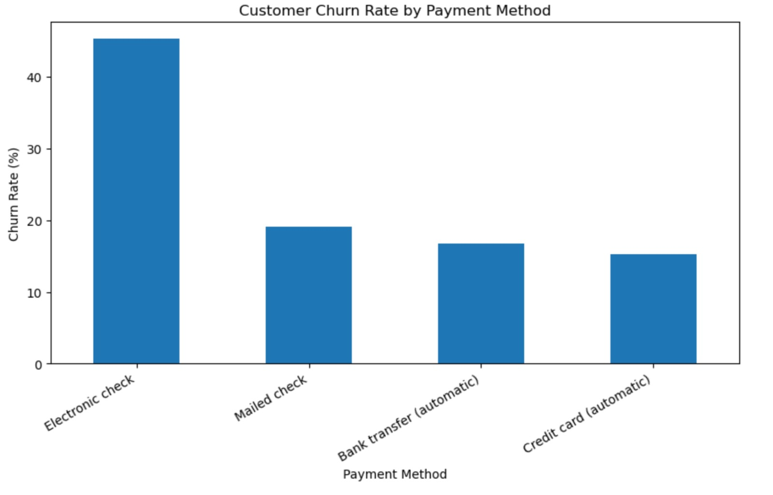
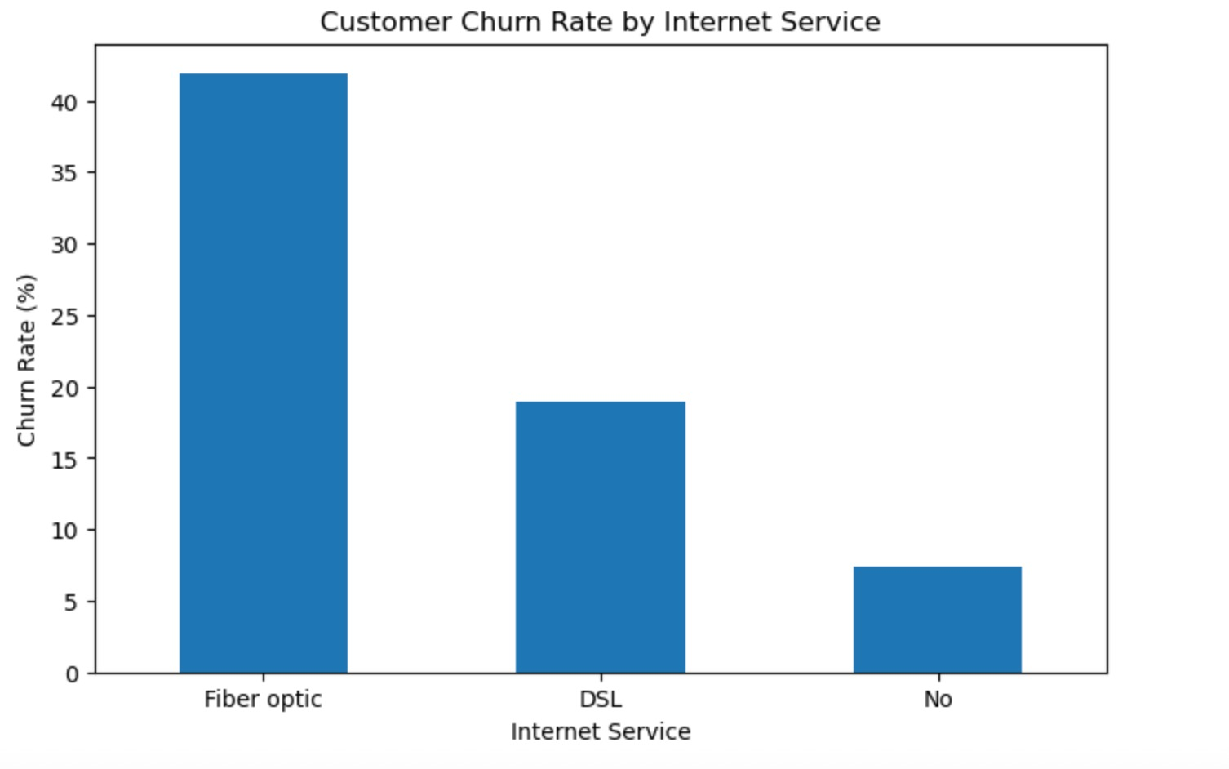
Payment and Service Patterns

Slide 9
Key Insights
Month-to-month customers have 42.71% churn, compared with 2.83% among two-year customers.
Customers with 0-12 months tenure have the highest churn at 47.44%.
Electronic-check customers have the highest payment-method churn at 45.29%.
Fiber-optic customers have 41.89% churn, considerably above DSL.

Slide 10
Recommendations
Target customers in their first 12 months.
Focus on suitable high-risk month-to-month customers.
Review payment experience, billing issues and customer journey.
Investigate pricing, reliability, installation and support.
Create a framework for identifying high-risk customers and monitoring retention interventions.

Slide 11
KPIs
Initiative | KPI
Early retention | 0-12 month churn rate
Contract conversion | Month-to-month conversion rate
Payment intervention | Electronic-check churn
Fiber review | Fiber-optic churn
Risk segmentation | Churn by risk segment
Overall performance | Overall churn rate

Slide 12
Conclusion
From the provided analysis ABC Communications can use targeted retention strategies, supported by measurable KPIs, to identify and address high-risk customer segments.

